Slide 1
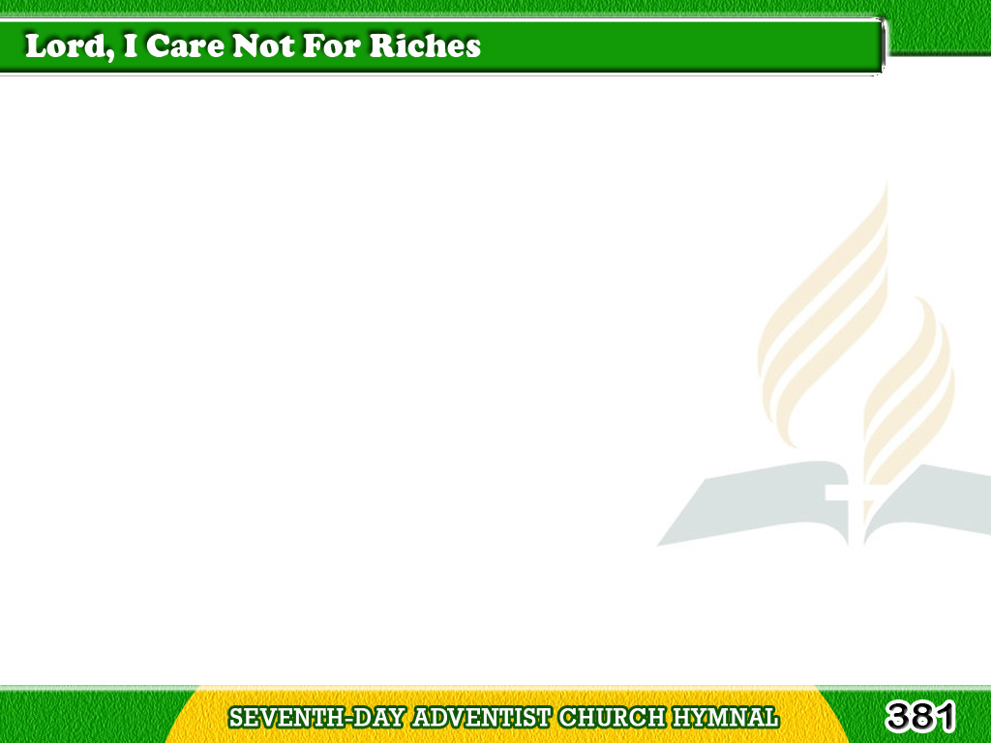
1/3
Lord, I care not for riches,
Neither silver nor gold;
I would make sure of heaven,
I would enter the fold;
Tagalog
Version

Slide 2
1/3
In the book of Thy kingdom
With its pages so fair,
Tell me, Jesus, my Saviour,
Is my name written there?
Tagalog
Version

Slide 3
1/3
Chorus
Is my name written there,
On the page white and fair?
In the book of Thy kingdom,
Is my name written there?
Tagalog
Version

Slide 4
2/3
Lord, my sins they are many,
Like the sands of the sea,
But Thy blood, O my Saviour,
is sufficient for me;
Tagalog
Version

Slide 5
2/3
For Thy promise is written
In bright letters that glow,
“Though your sins be as scarlet,
I will make them like snow.”
Tagalog
Version

Slide 6
2/3
Chorus
Is my name written there,
On the page white and fair?
In the book of Thy kingdom,
Is my name written there?
Tagalog
Version

Slide 7
3/3
Oh, that beautiful city,
With its mansions of light,
With its glorified beings
In pure garments of white;
Tagalog
Version

Slide 8
3/3
Where no evil thing cometh
To despoil what is fair,
Where the angels are watching
Is my name written there?
Tagalog
Version

Slide 9
3/3
Chorus
Is my name written there,
On the page white and fair?
In the book of Thy kingdom,
Is my name written there?
Tagalog
Version

